Slide 1
React Refs and the DOM
Sangeeth Sudhakaran

Slide 2
React refs
Refs is the shorthand used for references in React. Refs are a function provided by React to access the DOM element and the React element that you might have created your own.
They are used in cases where we want to change the value of a child component, without making use of props and all. They also provide us with good functionality as we can use callbacks with them.

Slide 3
When to use Refs
Refs can be used in the following cases:
When we need DOM measurements such as managing focus, text selection, or media playback.
It is used in triggering imperative animations.
When integrating with third-party DOM libraries.
It can also use as in callbacks.

Slide 4
When to not use Refs
Its use should be avoided for anything that can be done declaratively. For example, instead of using open() and close() methods on a Dialog component, you need to pass an isOpen prop to it.
You should have to avoid overuse of the Refs.
Should not be used with functional components because they don’t have instances.

Slide 5
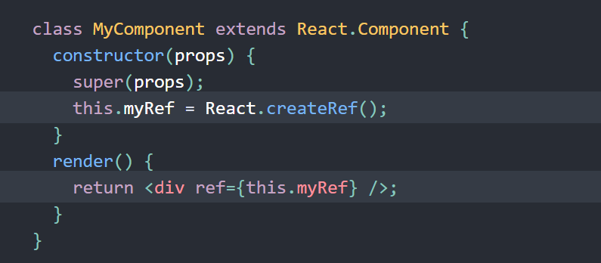
How to create refs
Refs are created using React.createRef() and attached to React elements via the ref attribute. Refs are commonly assigned to an instance property when a component is constructed so they can be referenced throughout the component.

Slide 6

Accessing Refs
When a ref is passed to an element in render, a reference to the node becomes accessible at the current attribute of the ref.

Slide 7
Adding a Ref to a DOM Element
React will assign the current property with the DOM element when the component mounts and assign it back to null when it unmounts.
ref updates happen before componentDidMount or componentDidUpdate lifecycle methods.

Slide 8
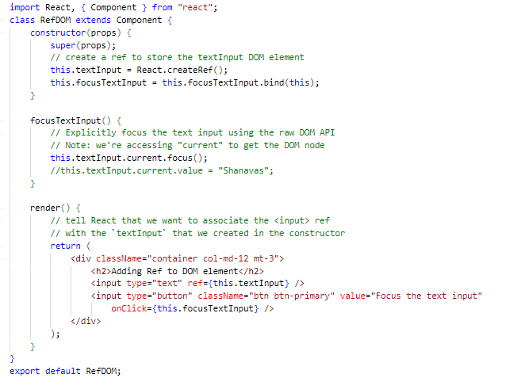

Slide 9
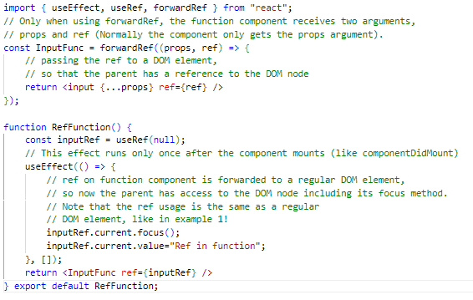
Adding a Ref to a function component
adding a ref to store the reference to a function component

Slide 10
Adding a Ref to a class component
If you want to use ref on the function component, you can use forwardRef or you can convert the component to a class.

Slide 11
Forwarding Ref from one component to another component
Ref forwarding is a technique that is used for passing a ref through a component to one of its child components. It can be performed by making use of the React.forwardRef() method.
This technique is particularly useful with higher-order components and specially used in reusable component libraries.

Slide 12
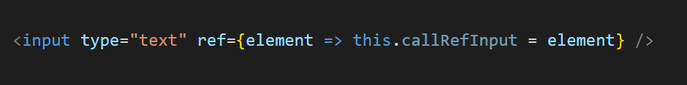
Callback Refs
In react, there is another way to use refs that is called "callback refs" and it gives more control when the refs are set and unset. Instead of creating refs by createRef() method, React allows a way to create refs by passing a callback function to the ref attribute of a component. It looks like the below code.
The callback function is used to store a reference to the DOM node in an instance property and can be accessed elsewhere

Slide 13

REACT WITH useRef()
It helps to get access the DOM node or element, and then we can interact with that DOM node or element such as focussing the input element or accessing the input element value. It returns the ref object whose .current property initialized to the passed argument. The returned object persist for the lifetime of the component.
Syntax :

Slide 14

Thank you

